Slide 1
Coalition for Physician Enhancement
Maintaining Physician Competence: A Global Perspective
Ottawa, Ontario
Oct 4, 2012
The New PEER Model: A (R)evolution in Peer Assessment at the CPSO
Presented by CPSO Research and Evaluation Team:
Rhoda Reardon, Nanci Harris, Wendy Yen, Craig Nathanson

Slide 2
Presentation Outline:
‘Back story’
Change Drivers
Vision
Delivering change – a work in process

Slide 3

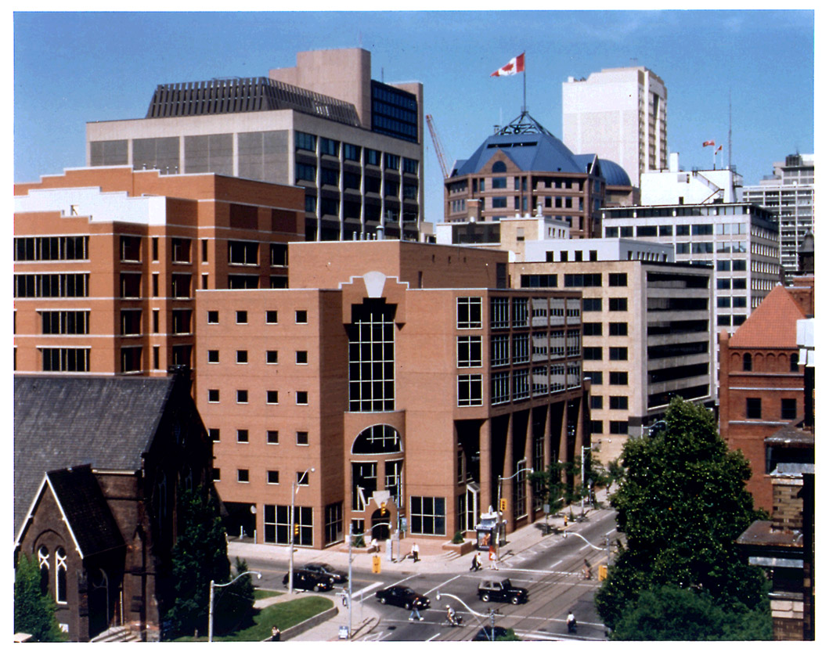
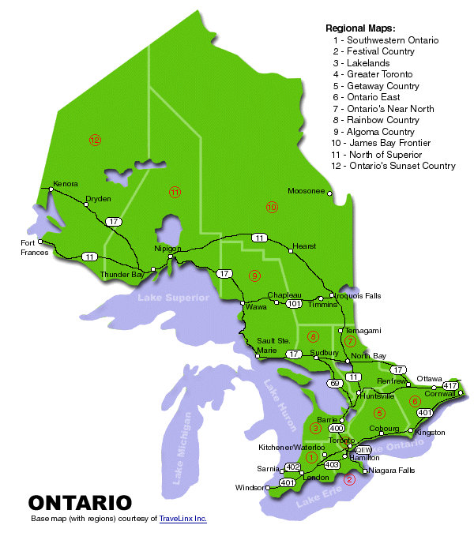
Who We Are
CPSO Registers and Regulates Ontario’s 30,000 Physicians

Slide 4
History of peer assessment at CPSO
Around since 1980
First of its kind in Canada
~ 385 trained peer assessors, ~ 1700 peer assessments annually
  Random and targeted (e.g., 70+ years old)

Slide 5
Current CPSO Peer Assessment Process
Random/Targeted Selection of Physicians
  Assessment Visit
  Review Charts
  Interview Physician
  Complete assessment module and Report
Match assessor to physician
Quality Assurance Committee reviews report; decides outcome
Satisfactory Performance:
No Further Action
Reassessment
Care Concerns found: Interview with Quality Assurance Committee
Notes:
In the CPSO peer assessment program,2-3% of the province’s 28,000 practising physicians are randomly selected for assessment on an annual basis.
Physician selection is random, independent of the complaints and investigative process where quality assessment is used as part of the investigative process.
Peer assessments are performed by a single trained practising physicians who achieved excellent ratings in previous peer assessments, and who have similar practice structures and patient populations. Inter-assessor reliability for peer-review assessment of the acceptability of quality of care is excellent (Kappa = .89).²⁰
DESCRIBE PEER PROCESS BRIEFLY
Who gets these? -Random assessments (~700/year); Age 70s (~150/year); Incident driven (~40/year); Most specialties
Who does the assessing? - Trained practising physicians; Practice matched; Previously assessed
For the purposes of this study we dichotomized the Assessment outcomes into : (i) acceptable with no further action, (ii) unacceptable requiring a) reassessment, or b) interview with the QAC to determine an immediate remediation plan.
***************************************************************
5

Slide 6
Drivers of Change
No common understanding of purpose of peer assessment program
Limited tracking of outcomes = difficult to measure impact
Eroding of structured delivery
Lack of alignment with modern frameworks, i.e., CanMEDS
Isolated, under-used assessors
Generic model not useful for specialties

Slide 7

Develop a common understanding of purpose of peer assessment program
Set the bar for peer assessment in Ontario and lead by example
Systematically track outcomes to determine impact (individual and program)
Link assessment to life-long learning and continuous improvement
Align peer assessment program – CanMEDS; quality “agenda”
Assessor training and resources to deliver the vision

Slide 8
Peer Assessment purpose:
Promote continuous quality improvement by providing physicians with feedback to validate appropriate care and show opportunities for practice improvement

Slide 9
P
E
E
R
The PEER model

Slide 10
P
Plan &
Prepare
Phase 1
pre-visit
E
Evaluate
Phase 2
practice visit
E
Engage
R
Phase 3
Post-visit
Reflect &
Respond
Notes:
** Formerly known as the Courtship Model

Slide 11
Purpose of phase 1 – Plan & Prepare
Introduce physician and assessor
Familiarize physician with program goals and process
Collect basic practice information
Familiarize the assessor with a physician’s practice
Create a plan for assessment visit
Collect discipline relevant practice information
Initiate process for multi-source feedback (pilot in 2013)
Initiate physician self-assessment using quality indicator tools

Slide 12
Purpose of Phase 2 Evaluate & Engage
Chart review
Review of other relevant sources of information (e.g., simulation)
Tailored, discipline specific assessment tools and chart selection
Facilitated feedback – review feedback and information and consider improvement opportunities (assessor feedback, MSF, self audit)
Recording improvement opportunities, developing QI or CPD plan (aligned with CFPC and RCPSC)
Assessor training e.g. effective feedback, CPD coaching

Slide 13
Purpose of phase 3 – Reflect &
Respond
Assessor report to College
Physician evaluates PEER experience
Physician completes his/her plan for QI or CPD and provides to College (Alignment – CFPC & RCPSC)
Follow-up with physician - outcome of QI/CPD plans
Feedback/outcomes of CPD - PEER program impact

Slide 14

Delivering change – a work in process

Slide 15
Assessor Networking Groups
~ 385 peer assessors
38 peer assessor network groups
Assessor Network Coordinator: communication conduit (2-way) network meetings; assessor recruitment & training; QI resources
Promote a ‘community of peer assessors’, committed to program improvement

Slide 16
Quality Indicator Template
Element | Question | What does this mean?
Definition | What is quality? | Statement to define quality (i.e., the indicator itself)
Evidence | Says who? | Source of evidence/authority that supports this quality indicator
CanMEDS | How is this item aligned with CanMEDS? | Indicator is clearly linked to one or more of the CanMEDS roles and competencies
Criteria | How will you know quality when you see it? | Common evaluation criteria to allow assessors to consistently determine if this indicator has been met
Resources | If quality is absent, how can it be improved? | Resources available to assist physicians who have not met this indicator
Agreement | Who needs to agree on this indicator? | Broad consensus among relevant stakeholders that this indicator is accurate, relevant and feasible to assess

Slide 17
Building with our assessors
7 networking groups identified to be ‘trail-blazers’ for this task
Volunteers identified to form working groups
Initial in-person meetings completed
Facilitation & measurement expertise from CPSO staff
Use of on-line collaboration and survey tools to facilitate process

Slide 18
Development Process Overview
Assessor working group drafts:
tailored pre-assessment questionnaire
medical expert assessment module
chart selection process
Step 1
Step 2
All assessors in networking group reach consensus on a), b) & c)
Selected stakeholder consultation; cross discipline consultation
Step 3
Step 4
Pilot - offline
Step 5
Live pilot; implement

Slide 19
Building Assessment Tools with assessors
Strengths
Building on 30 years experience with peer assessment
Cadre of skilled assessors with focused practice expertise
Assessors arranged into networking groups with defined leads
Staff support to coordinate assessor networks
Challenges
Maintain existing operations while ‘revising’
Pace: risk of frustrating assessors anxious to use new instruments
Focus beyond identifying ‘quality’ to include evidence, assessment criteria and practice improvement resources
Effective, yet feasible piloting processes

Slide 20

Hospitalist assessment module

Slide 21
Interaction Goals
Engaging learning process for all participants
Opportunity to contribute where your interest lies
Useful input for our program
Discussion Themes
Measuring outcomes in practice
Setting bar for peer assessment
Assessment as a trigger for QI or CPD planning.
Building assessor skills to deliver the PEER vision
Wild card

Slide 22
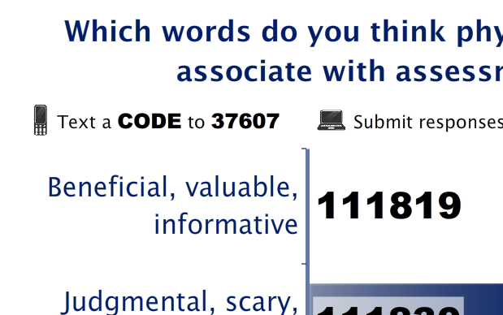
Don’t forget: You can copy-paste this slide into other presentations, and move or resize the poll.
Notes:
Press F5 or enter presentation mode to view the poll
In an emergency during your presentation, if the poll isn't showing, navigate to this link in your web browser:
http://www.polleverywhere.com/multiple_choice_polls/MTQxMTk5NDYyMA
If you like, you can use this slide as a template for your own voting slides. You might use a slide like this if you feel your audience would benefit from the picture showing a text message on a phone.

Slide 23
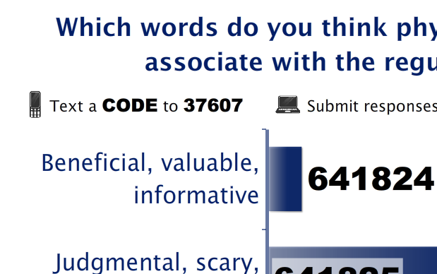
Don’t forget: You can copy-paste this slide into other presentations, and move or resize the poll.
Notes:
Press F5 or enter presentation mode to view the poll
In an emergency during your presentation, if the poll isn't showing, navigate to this link in your web browser:
http://www.polleverywhere.com/multiple_choice_polls/NDIyOTY1NjEx
If you like, you can use this slide as a template for your own voting slides. You might use a slide like this if you feel your audience would benefit from the picture showing a text message on a phone.

Slide 24
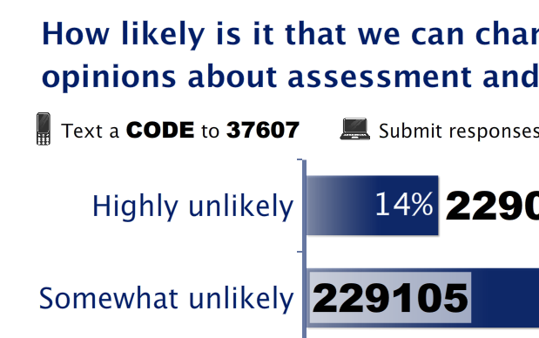
Don’t forget: You can copy-paste this slide into other presentations, and move or resize the poll.
Notes:
Press F5 or enter presentation mode to view the poll
In an emergency during your presentation, if the poll isn't showing, navigate to this link in your web browser:
http://www.polleverywhere.com/multiple_choice_polls/MTI1MTgwODQ1Nw
If you like, you can use this slide as a template for your own voting slides. You might use a slide like this if you feel your audience would benefit from the picture showing a text message on a phone.

Slide 25
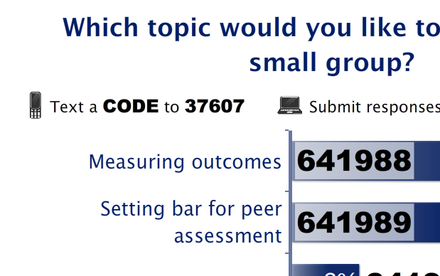
Don’t forget: You can copy-paste this slide into other presentations, and move or resize the poll.
Notes:
Press F5 or enter presentation mode to view the poll
In an emergency during your presentation, if the poll isn't showing, navigate to this link in your web browser:
http://www.polleverywhere.com/multiple_choice_polls/LTYwOTEwMjc3Mg
If you like, you can use this slide as a template for your own voting slides. You might use a slide like this if you feel your audience would benefit from the picture showing a text message on a phone.

